Slide 1
KYTC Partnering Conference
Everyone Knows Where Everyone Goes

Slide 2
The Goal of our Project Delivery??
Reliability

Slide 3
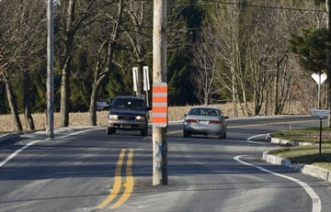
A Common View of Utility Coordination
Utility Coordination is a means to get the utilities out of the way of our road project.

Slide 4
Traditional PDP and Utility Coordination
Survey, 811 Design ticket
Initiate NEPA, Design line and grade assumptions
Conduct Preliminary Field Check
Complete NEPA, Public Hearing
Establish the Right-of-way
Design the project to 75-90% plans
Bring in the utility companies to finalize coordination after final plans
Certify to FHWA the UC is done!
Construct the project/ pray
Notes:
Natalie

Slide 5
“OUR” ROW Approach
Often a plan to construct utility facilities isn't fully developed
May not be sufficient ROW for the utility to relocate
May violate permits or NEPA commitments
Unforeseen surprises in costs and time for both Utilities and project owners
No discussion on practical design alternatives to save time and money-
Unnecessary relocations
Consultants expect to be paid to “re-design” to avoid costly utilities
Delays in CN=Change Orders=Frustration
Establishes / Reinforces a Confrontational Approach

Slide 7
New Paradigm to Utility Coordination
Treat the Utility companies as business partners from the planning of, and initial development of every project so that the most cost effective approach can be delivered for the public interest!

Slide 8
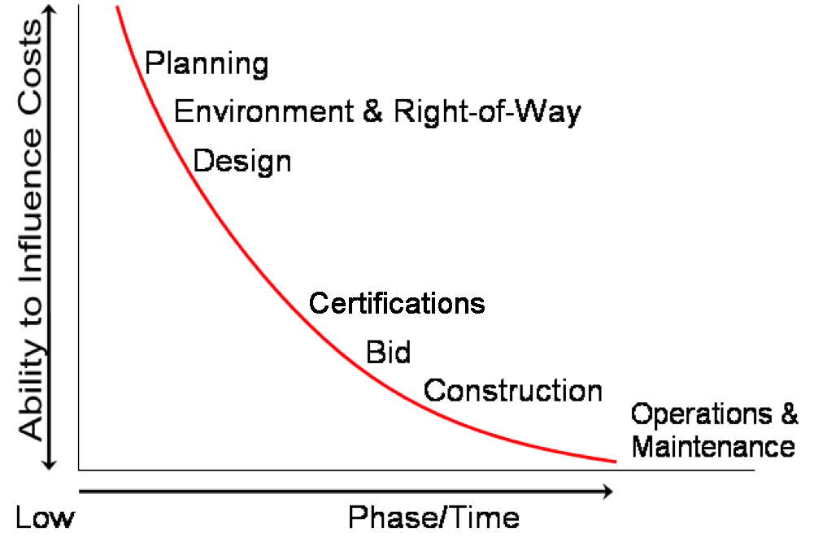
EARLIER COORDINATION SAVES $$

Slide 10
Build a Utility Awareness throughout Project Development
Planning
NEPA
ROW
DESIGN
CONSTRUCTION BID DOCUMENTS
CONSTRUCTION
MAINTENANCE

Slide 11
New Paradigm for Utility Coordination
Live interaction! Not simply email!
Understand what is important to each of our partners with their facilities!
Align partner goals with the project!

Slide 12
Build a New Mindset into Design!
Avoid
Minimize
Mitigate

Slide 13
Why beginning a project by surveying “One Call” marks is not sufficient!

Slide 14
Identify and address the DNA of your Critical Path!

Slide 15
EVERYONE KNOWS WHERE EVERYONE GOES

Slide 16
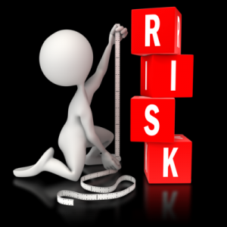
Assessing Your Risk
Utility Coordinators should quantify risk…
... and know when the risk is TOO much!
The New Paradigm

Slide 17
Risk
Risk Assessment
Tangible Risk
Knowledge
Relationship
Process
Scope
Schedule
Budget
Intangible Risk
The New Paradigm
Notes:
Incomplete or sloppy work creates risk
Creates hidden costs
Results in strained partnerships
Surprises
Knowing “why” is more important than checklists, go beyond steps and procedural milestones
Knowing your partners… minimizes risk
Understanding the why’s behind the what’s…
Creates partnerships
Minimizes risks
Gives everyone a voice
Develops trust
Creates a “win-win” mentality
Results in goals being met, on time and on budget

Slide 18
Risk Management
The single biggest problem in communication is the allusion that it has taken place.
~George Bernard Shaw
The New Paradigm

Slide 19
Relocation Tools
Drawing of Sufficient Details
On Project Plans to scale
Show Elevations at all critical locations
Work Plans
Master Utility Plans
Construction Sequencing

Slide 20
EVERYONE KNOWS WHERE EVERYONE GOES
The New Paradigm

